Slide 1

SHARDA SCH O O L O F E N G I N E E R I N G & T E C H N O L O G Y
D E P A R T M E N T O F C O M P U T E R S C I E N C E E N G I N E E R I N G
Course: Data Compression
Course Code: 705210502
Mathematical Preliminaries for Data Compression
Dr. Gyana Ranjana Panigrahi

Slide 2

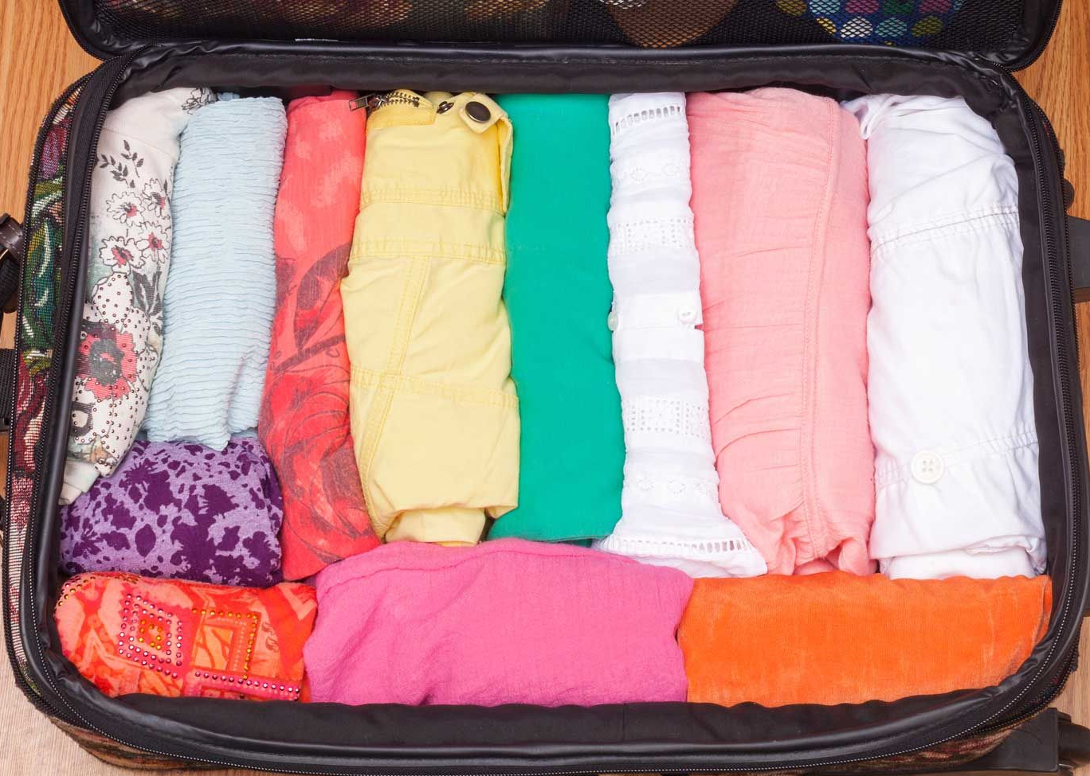
Mathematical Preliminaries for Data Compression
Why Use Math in Data Compression?
Think of data compression like packing clothes in a suitcase.
You want to save space without damaging anything.
Calculations helps you:
Measure how much information is in your data.
Decide how many bits are needed to represent it.
Find ways to reduce space without losing meaning (like folding clothes better).

Slide 3

How much surprise is in a message?
Represent common vs. rare events:
So, if an event is very likely (like 1/2), it gives less surprise high probability of occurring=1.
If it’s very rare (like 1/16), it gives more surprise very low probability of occurring=0.
This helps us illustrate a core idea: Less likely events carry more information (higher bits).
Let’s say you're guessing today’s weather.
If someone tells you:
"It's raining in the desert" — surprising
"It’s hot in summer in India" — not surprising
Formula:
I(x)= Information Content of an event x, It’s for one symbol/event.
Where:
P(x) = probability of the event happening/symbol.
log⁡₂ means "log base 2", used because computers use binary.

Slide 4
SHARDA SCH O O L O F E N G I N E E R I N G & T E C H N O L O G Y
D E P A R T M E N T O F C O M P U T E R S C I E N C E E N G I N E E R I N G
Think of:
A coin toss → heads/tails = 1/2 → needs 1 bit
Rolling a die and getting a specific number → 1/6 (approx 0.167) → needs ~2.58 bits
Guessing a password from 1 in 16 options → needs 4 bits to represent
These powers of 2 match real-world binary encoding
2 values (1/2) → needs 1 bit → like a coin toss (0 or 1)
4 values (1/4) → needs 2 bits → like 00, 01, 10, 11
16 values (1/16) → needs 4 bits → like 0000 to 1111

Slide 5

SHARDA SCH O O L O F E N G I N E E R I N G & T E C H N O L O G Y
D E P A R T M E N T O F C O M P U T E R S C I E N C E E N G I N E E R I N G
Real-Life Calculation:
Let’s say:
Probability of event A = 1/2 → common
Probability of event B = 1/16 → rare
Now calculate surprise:
More rare → More bits needed to describe it

Slide 6
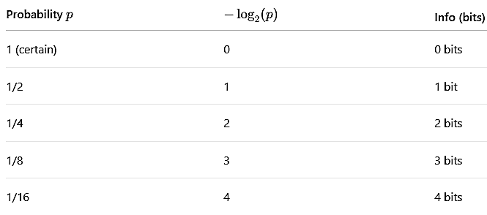
General Rule to Remember:
So, lower the probability, higher the information (more bits required).

Slide 7

SHARDA SCH O O L O F E N G I N E E R I N G & T E C H N O L O G Y
D E P A R T M E N T O F C O M P U T E R S C I E N C E E N G I N E E R I N G
Entropy — How much info on average per symbol?
Let’s say you're texting using only 3 emojis:
Emoji | Probability
😊 | 0.5
😢 | 0.3
😡 | 0.2
Entropy formula:
H(X): Entropy of Source X
It tells us:
“How much information is there on average in each symbol we send or store?”

Slide 8
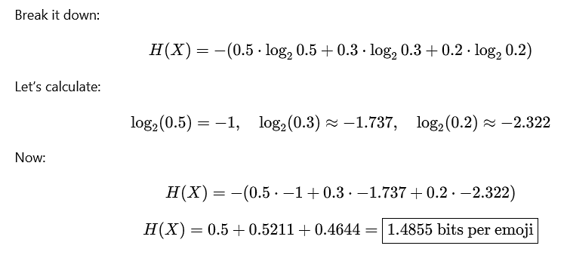

On average, you need 1.48 bits to store each emoji in this case
If all emojis had equal chance (1/3), entropy would be:
You need about 1.49 bits per emoji, on average, to store or transmit them efficiently.
The lower the entropy, the more redundancy → easier to compress.
The higher the entropy, the more randomness → harder to compress.

Slide 9
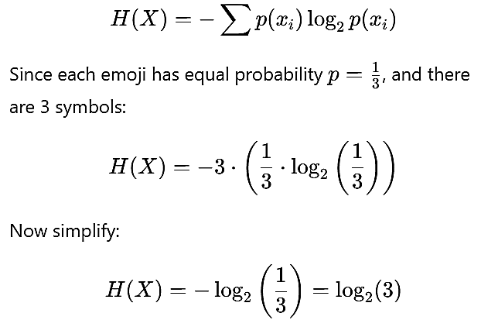
If all emojis had equal chance (1/3), entropy would be:

Slide 10
SHARDA SCH O O L O F E N G I N E E R I N G & T E C H N O L O G Y
D E P A R T M E N T O F C O M P U T E R S C I E N C E E N G I N E E R I N G
Imagine you're watching a TV channel:
If the news anchor keeps repeating “Breaking news” over and over, it’s boring — there’s low information.
But if the anchor says something new and unexpected every second, there’s high information.
Entropy is a number that measures how "informative" or "surprising" a source is.

Slide 11
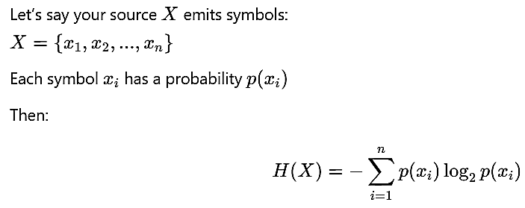
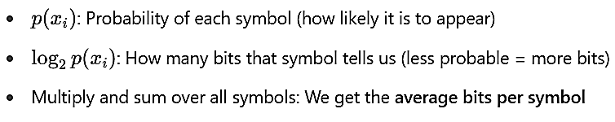
Mathematical Definition of Entropy
SHARDA SCH O O L O F E N G I N E E R I N G & T E C H N O L O G Y
D E P A R T M E N T O F C O M P U T E R S C I E N C E E N G I N E E R I N G

Slide 12
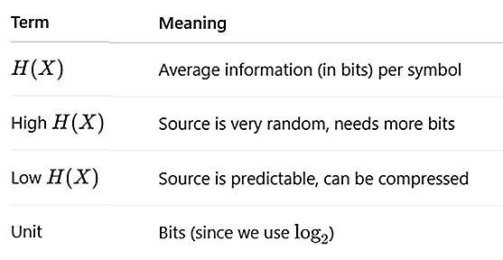

Slide 13

Redundancy — What’s compressible?
Redundancy = Extra bits due to uneven probability.
If n = 3 emojis:
Means you can save ~0.1 bit per emoji using compression.

Slide 14

SHARDA SCH O O L O F E N G I N E E R I N G & T E C H N O L O G Y
D E P A R T M E N T O F C O M P U T E R S C I E N C E E N G I N E E R I N G

